Slide 1
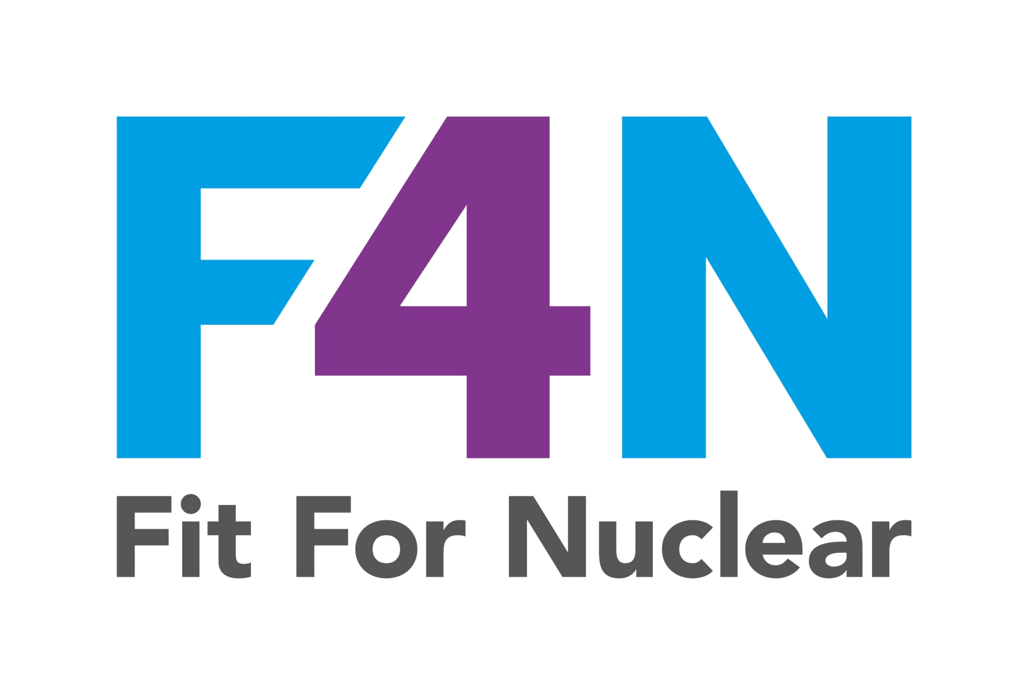

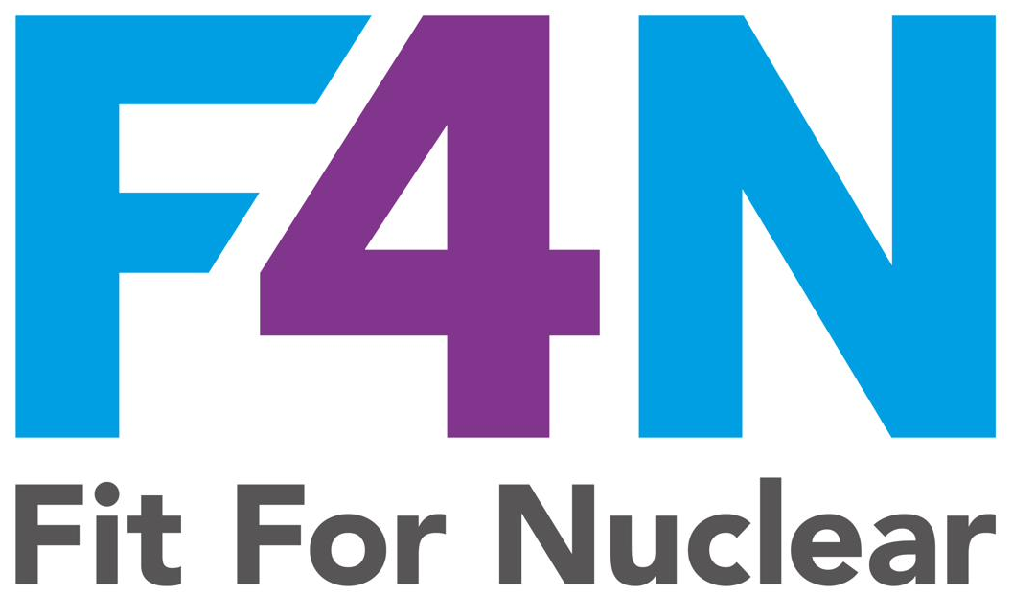
FIT FOR NUCLEAR
Leadership Behaviour Framework
Defining what great leadership looks like in your organisation
Strategy & Leadership Toolkit | SL-08
NucCol | Nuclear Collaboration Ltd · Fit For Nuclear Programme · Commercial in Confidence | 1

Slide 2
Why Leadership Behaviours Matter for F4N
It's not just what leaders do — it's how they do it
F4N assessors specifically evaluate visible leadership — not just whether a leadership team exists, but whether leaders behave in ways that embed safety culture, drive improvement, and create accountability. This framework helps you define, communicate, and assess leadership behaviours across your organisation.
Visible Safety Leadership
Leaders are regularly seen on the shopfloor actively engaging on safety — not just receiving reports. They demonstrate ALARP thinking and stop-work authority in their own decisions.
Questioning Attitude
Leaders model the questioning attitude expected of all staff. They ask 'why?' and 'what could go wrong?' They celebrate people who raise concerns rather than shooting the messenger.
Conservative Decision-Making
When trade-offs arise between safety/quality and schedule/cost, leaders consistently demonstrate that safety wins. This must be visible — words alone are not enough.
Coaching & Development
Leaders invest time in developing people. They are mentors and coaches, not just managers. They understand that nuclear readiness requires continuous competence development.
2
NucCol | Nuclear Collaboration Ltd · Fit For Nuclear Programme · Commercial in Confidence | 2

Slide 3
Leadership Behaviour Framework
Six leadership dimensions — define what 'good' looks like at each level
1. Safety & Culture Leadership
2. Strategic Direction
Actively champions safety. Models nuclear safety behaviours. Creates an environment where concerns are raised freely.
Communicates vision clearly. Translates strategy into team objectives. Reviews progress and adjusts plans accordingly.
3. People Development
4. Driving Performance
Develops people's potential. Gives constructive feedback. Creates PDPs and follows through. Builds succession capability.
Sets clear expectations. Holds self and others accountable. Uses data to make decisions. Drives CI with urgency.
5. Customer & Quality Focus
6. Collaboration & Communication
Keeps customer requirements at the forefront. Ensures quality standards are understood and met. Never compromises on quality.
Communicates openly and honestly. Listens actively. Builds trust across teams. Shares information proactively.
3
NucCol | Nuclear Collaboration Ltd · Fit For Nuclear Programme · Commercial in Confidence | 3

Slide 4
Leadership Self-Assessment Matrix
Assess leadership behaviours against four maturity levels
Behaviour | Not Yet Demonstrated (0) | Developing (2) | Practised (7) | Exemplary (10)
Safety Leadership | Safety is delegated. Leader rarely visible on shopfloor. | Leader attends safety meetings but engagement is passive. | Leader conducts regular safety walks and acts on findings. | Leader coaches others on safety culture. Near-miss reporting is celebrated.
Strategic Direction | Team unaware of company strategy or objectives. | Team have been told the strategy but cannot articulate it. | Team understand objectives and their individual contribution. | Team co-own strategy. Cascade is two-way. Everyone can explain their impact.
People Development | No PDPs in place. Training is reactive. | PDPs exist but are rarely reviewed or acted upon. | PDPs are live, reviewed annually, linked to strategy. | Leader coaches team members. Succession is planned. Talent is developed proactively.
Driving Performance | KPIs not visible or discussed with team. | KPIs displayed but team engagement is limited. | KPIs reviewed in regular team meetings with clear actions. | Team own their KPIs. CI is led from within the team. Accountability is mutual.
Quality Focus | Quality issues are escalated upward — no ownership at team level. | Some quality awareness but inconsistent standards. | Team understand quality requirements and own first-line quality checks. | Quality is a team value. Non-conformances are actively reported and analysed.
4
NucCol | Nuclear Collaboration Ltd · Fit For Nuclear Programme · Commercial in Confidence | 4

Slide 5
Nuclear Safety Leadership Behaviours
What the F4N assessment and nuclear clients expect to see
🎯
ALARP Decision-Making
🛑
Stop-Work Authority
❓
Questioning Attitude
Every decision with safety implications is demonstrably ALARP. Leaders can explain their reasoning.
Leaders actively encourage and celebrate staff who stop work for safety concerns. Never penalise.
Leaders ask challenging questions. They don't accept 'we've always done it this way' as an answer.
👁
Visible Presence
📖
Learning from Events
🏆
Conservative Culture
Regular, meaningful shopfloor engagement — not walkabouts. Talk about safety, quality, and culture.
OPEX (Operational Experience) is reviewed and shared. Lessons from incidents are embedded in processes.
Schedule and cost are always secondary to safety and quality. This culture starts at the top.
5
NucCol | Nuclear Collaboration Ltd · Fit For Nuclear Programme · Commercial in Confidence | 5

